Slide 1
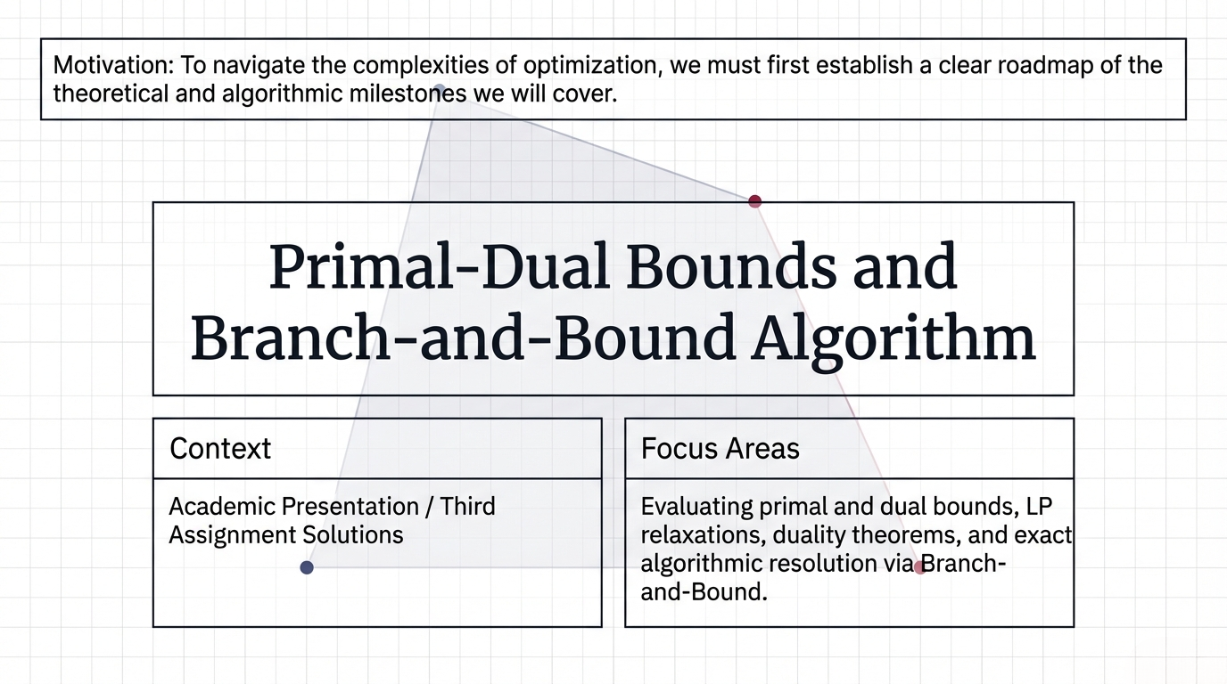
Notes:
Slide 1: Title Slide "Welcome to our academic presentation covering the third assignment solutions. Today, our focus will be on Primal-Dual Bounds and the Branch-and-Bound Algorithm. We will evaluate primal and dual bounds, LP relaxations, duality theorems, and exact algorithmic resolution via Branch-and-Bound. To navigate the complexities of optimization, we must first establish a clear roadmap of the theoretical and algorithmic milestones we will cover today

Slide 2
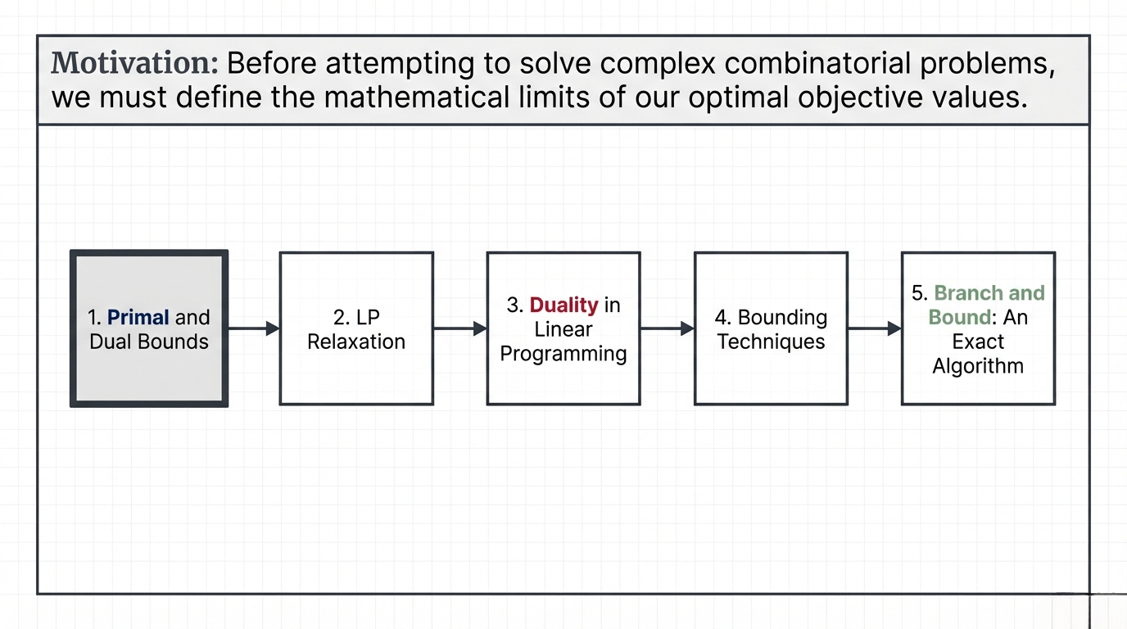
Notes:
Slide 2: Outline "Our roadmap is structured into five core sections. We will begin with Primal and Dual Bounds, followed by LP Relaxation, and Duality in Linear Programming. Then, we will explore various Bounding Techniques before culminating in the Branch and Bound exact algorithm. Before attempting to solve complex combinatorial problems, we must define the mathematical limits of our optimal objective values."

Slide 3
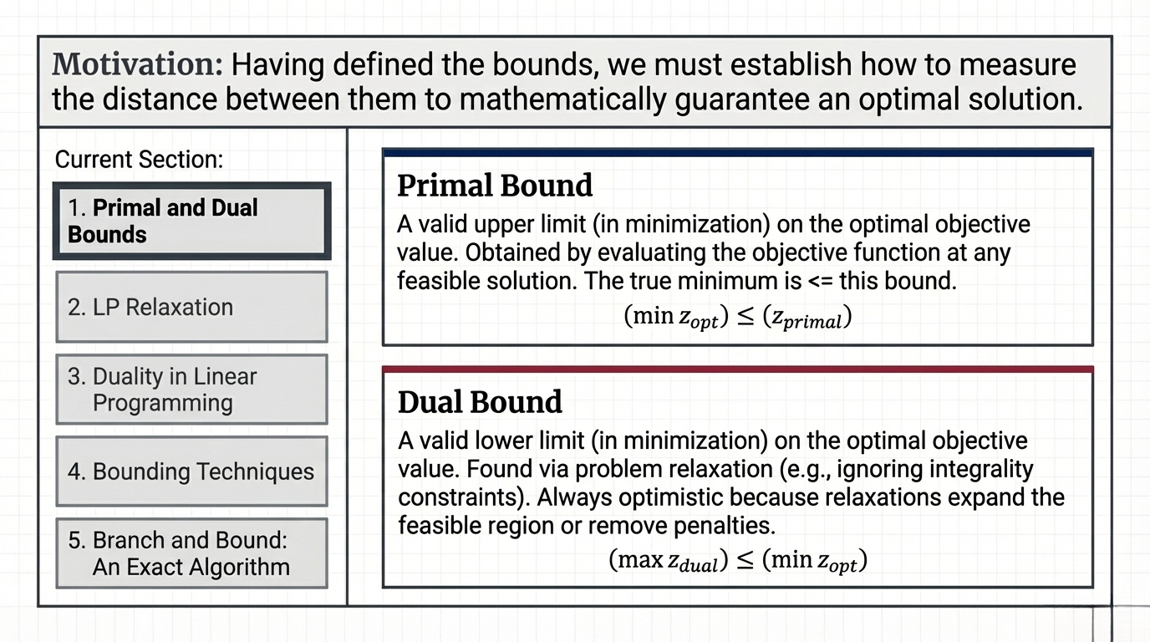
Notes:
Slide 3: Primal and Dual Bounds "Let's start by defining our mathematical limits. A Primal Bound acts as a valid upper limit in minimization problems, obtained by evaluating the objective function at any feasible solution. The true minimum is always less than or equal to this bound. Conversely, a Dual Bound is a valid lower limit, typically found via problem relaxation. It is always optimistic because relaxations expand the feasible region or remove penalties. Having defined the bounds, we must establish how to measure the distance between them to mathematically guarantee an optimal solution.

Slide 4
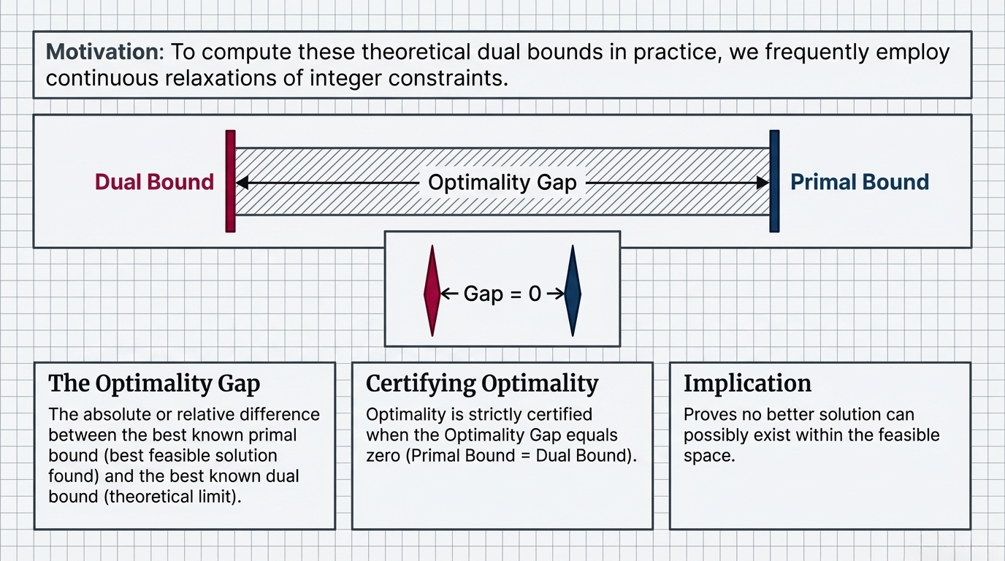
Notes:
Slide 4: The Optimality Gap "This distance is known as the Optimality Gap—the absolute or relative difference between the best known primal bound, which is the best feasible solution found, and the best known theoretical dual bound. Optimality is strictly certified when this gap equals exactly zero, meaning the Primal Bound equals the Dual Bound. The vital implication here is that a zero gap proves no better solution can possibly exist within the feasible space. To compute these theoretical dual bounds in practice, we frequently employ continuous relaxations of integer constraints.“
define the optimality gap. The optimality gap is the absolute or relative difference between the best known primal bound 1 (the best feasible solution found so far) and the best known dual bound (the theoretical limit).
Relaxing a problem means removing integer restrictions so variables can take continuous values, making the problem easier to solve.
“Relaxing a problem = ignoring integrality constraints”
🔹 Why it's useful (very important)
Used in:
Branch and Bound
Dual bounds
Approximation of optimal solution

Slide 5
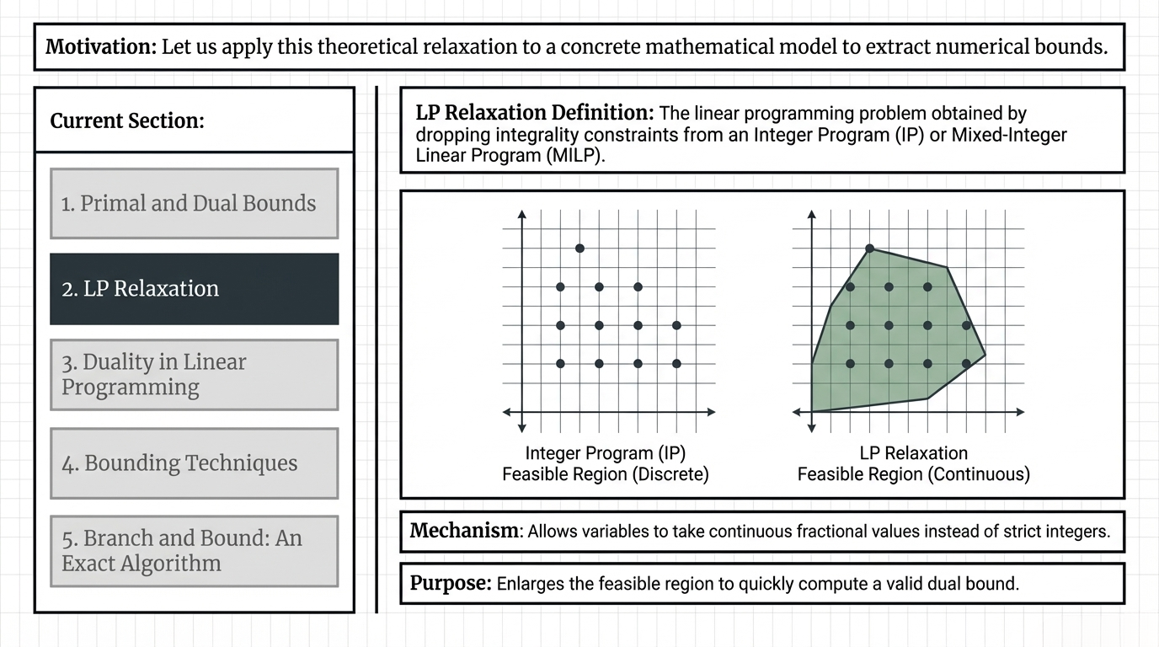
Notes:
Slide 5: LP Relaxation "This brings us to the concept of LP Relaxation. By definition, an LP relaxation drops the integrality constraints from an Integer Program or Mixed-Integer Linear Program. As you can see in the diagrams comparing discrete and continuous feasible regions, this mechanism allows variables to take continuous fractional values instead of strict integers. Its core purpose is to enlarge the feasible region to quickly compute a valid dual bound. Let us apply this theoretical relaxation to a concrete mathematical model to extract numerical bounds.“
Relaxing a problem means removing integer restrictions so variables can take continuous values, making the problem easier to solve.
“Relaxing a problem = ignoring integrality constraints”
🔹 Why it's useful (very important)
Used in:
Branch and Bound
Dual bounds
Approximation of optimal solution

Slide 6
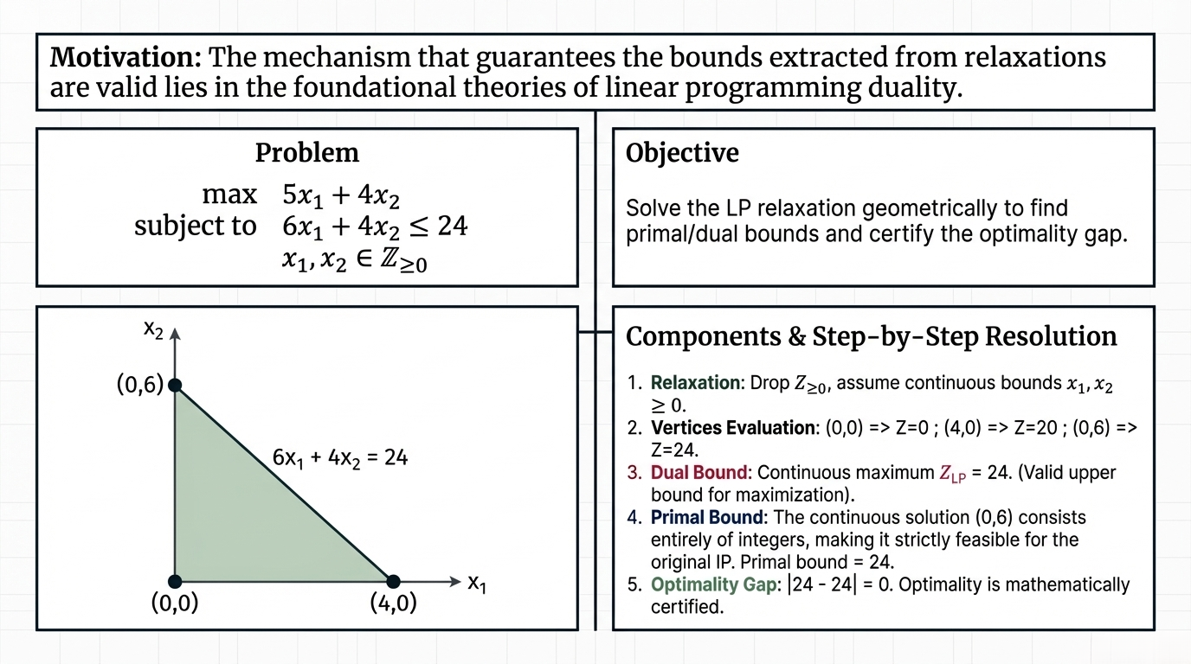
Notes:
Slide 6: LP Relaxation Example "Consider this maximization problem where variables must be non-negative integers. We apply LP relaxation by dropping the integrality constraints and assuming continuous bounds. By geometrically evaluating the vertices at (0,0), (4,0), and (0,6), we find that the continuous maximum—our dual bound—is 24. Because the continuous solution at (0,6) consists entirely of integers, it makes it strictly feasible for the original Integer Program, establishing our primal bound at 24 as well. Consequently, the optimality gap is exactly zero, and optimality is mathematically certified. The mechanism that guarantees the bounds extracted from relaxations are valid lies in the foundational theories of linear programming duality.“

Slide 7
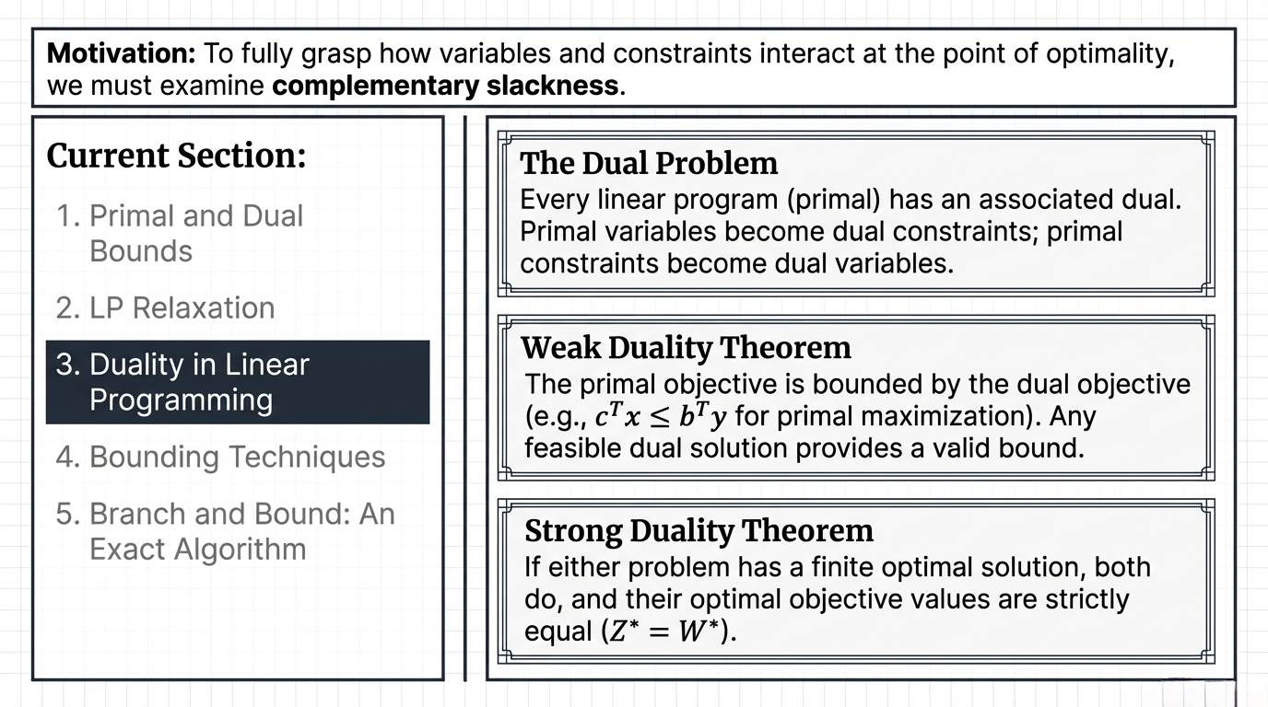
Notes:
Slide 7: Duality in Linear Programming "Let's explore this duality. Every linear program, or primal problem, has an associated dual problem where primal variables become dual constraints and primal constraints become dual variables. The Weak Duality Theorem states that the primal objective is bounded by the dual objective; thus, any feasible dual solution provides a valid bound. More importantly, the Strong Duality Theorem dictates that if either problem has a finite optimal solution, both do, and their optimal objective values are strictly equal. To fully grasp how variables and constraints interact at the point of optimality, we must examine complementary slackness.“
Weak Duality ensures that dual bounds are always valid lower bounds and primal solutions give upper bounds.
Weak Duality:
Dual≤Primal\text{Dual} \leq \text{Primal}Dual≤Primal
Strong Duality:
Optimal Primal=Optimal Dual\text{Optimal Primal} = \text{Optimal Dual}Optimal Primal=Optimal Dual
For any feasible solutions:
Dual value≤Primal value\text{Dual value} \leq \text{Primal value}Dual value≤Primal value
For a minimization problem:
Dual bound (DB) → lower bound
Primal bound (PB) → upper bound
👉 Therefore:
Dual Bound≤Optimal Value≤Primal Bound\text{Dual Bound} \leq \text{Optimal Value} \leq \text{Primal Bound}Dual Bound≤Optimal Value≤Primal Bound

Slide 8
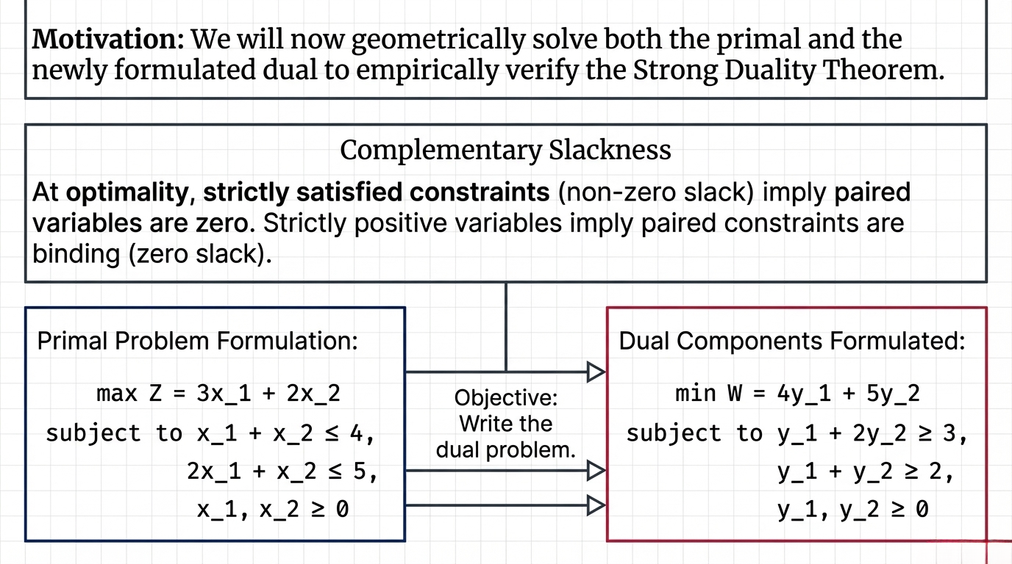
Notes:
Slide 8: Complementary Slackness "Complementary slackness dictates that at optimality, strictly satisfied constraints with non-zero slack imply their paired variables are exactly zero. Conversely, strictly positive variables imply their paired constraints are binding with zero slack. Here, we formulate the dual components from our primal maximization problem. We will now geometrically solve both the primal and the newly formulated dual to empirically verify the Strong Duality Theorem.“
👉 Complementary slackness links primal feasibility and dual feasibility by stating that only binding constraints can have positive dual values.
Complementary Slackness: 👉 Slack ↔ dual = 0, Binding ↔ dual ≥ 0

Slide 9
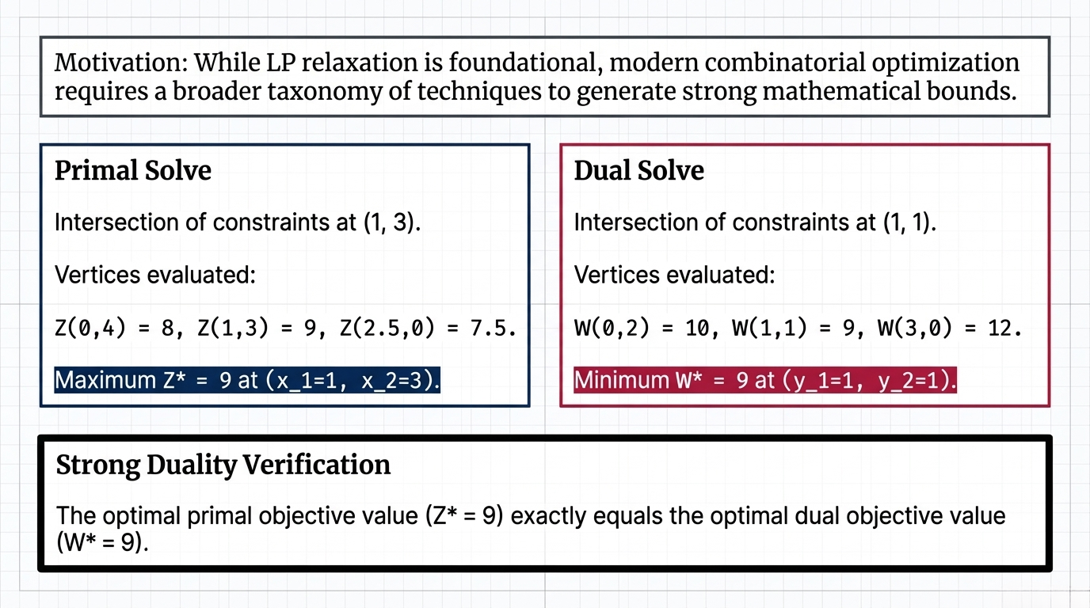
Notes:
Slide 9: Strong Duality Verification "By evaluating the intersection of constraints for the primal problem, we find the maximum Z* is 9 at the point (1, 3). Simultaneously, evaluating the dual vertices gives a minimum W* of 9 at (1, 1). This empirically verifies the Strong Duality Theorem, as the optimal primal objective value exactly equals the optimal dual objective value. While LP relaxation is foundational, modern combinatorial optimization requires a broader taxonomy of techniques to generate strong mathematical bounds."

Slide 10
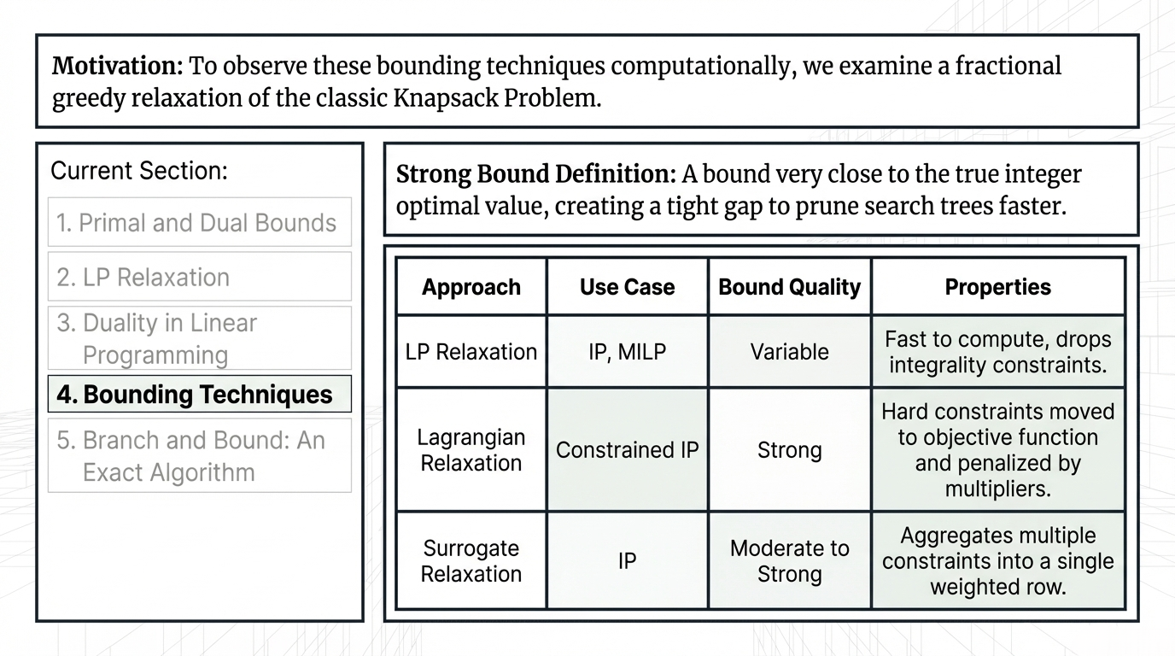
Notes:
Slide 10: Bounding Techniques "Let's look at this taxonomy of bounding techniques. A strong bound is one very close to the true integer optimal value, which creates a tight gap to prune search trees faster. While LP Relaxation is fast to compute, its bound quality is variable. Lagrangian Relaxation, used for Constrained IPs, provides strong bounds by moving hard constraints to the objective function and penalizing them by multipliers. Surrogate Relaxation offers moderate to strong bounds by aggregating multiple constraints into a single weighted row. To observe these bounding techniques computationally, we examine a fractional greedy relaxation of the classic Knapsack Problem.“
By dropping integrality constraints, the feasible region is enlarged. Because the solver optimizes over a larger set of possibilities, the continuous optimum will always be greater than or equal to (for maximization) the restricted integer optimum.

Slide 11
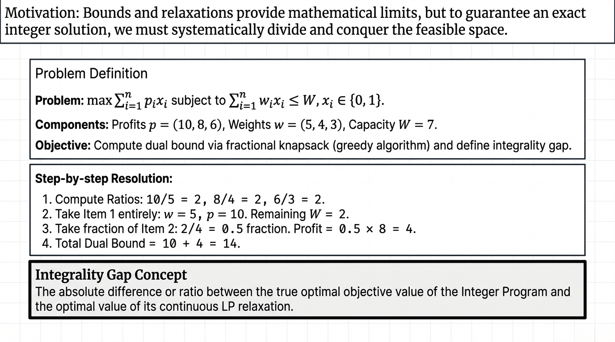
Notes:
Slide 11: Knapsack Example "In this Knapsack Problem, we want to maximize profit without exceeding a capacity of 7. We first compute the profit-to-weight ratios, which are all 2. Following a greedy approach, we take Item 1 entirely, giving a profit of 10 and leaving a remaining capacity of 2. We then take a 0.5 fraction of Item 2, adding a profit of 4. Our total dual bound is 14. The integrality gap represents the absolute difference or ratio between this continuous LP relaxation optimum and the true integer optimal value. Bounds and relaxations provide mathematical limits, but to guarantee an exact integer solution, we must systematically divide and conquer the feasible space."

Slide 12
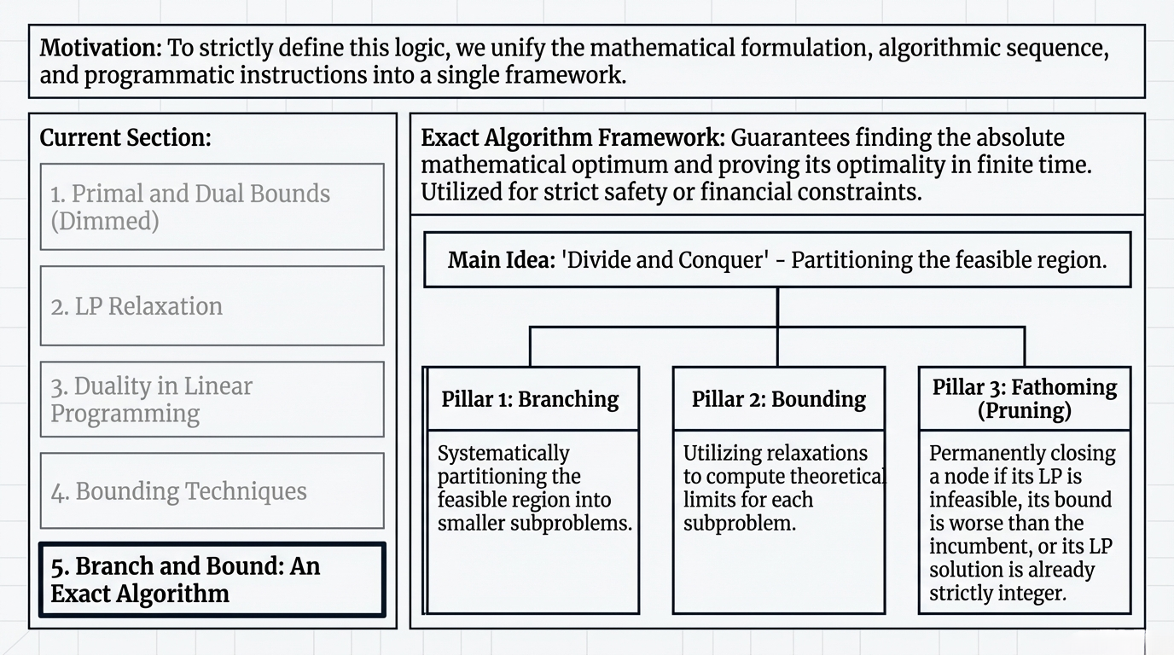
Notes:
Slide 12: Branch and Bound: An Exact Algorithm "This leads us to the Branch-and-Bound exact algorithm framework. Utilizing a 'Divide and Conquer' approach to partition the feasible region, it guarantees finding the absolute mathematical optimum and proving its optimality in finite time. It rests on three pillars: Branching, which systematically partitions the feasible region into smaller subproblems; Bounding, which utilizes relaxations to compute theoretical limits for each subproblem; and Fathoming or Pruning, which permanently closes a node if its LP is infeasible, its bound is worse than the incumbent, or its LP solution is already strictly integer. To strictly define this logic, we unify the mathematical formulation, algorithmic sequence, and programmatic instructions into a single framework."

Slide 13
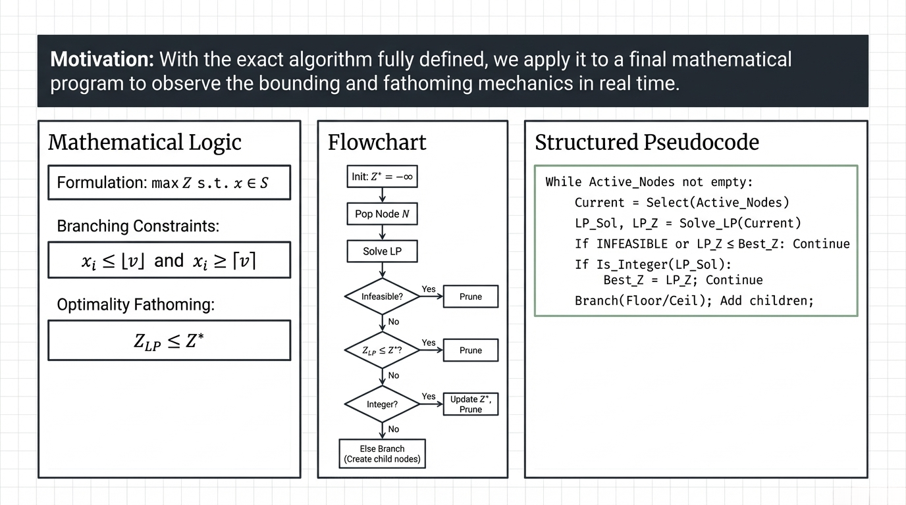
Notes:
Slide 13: B&B Flowchart and Logic "Here is the unified mathematical and algorithmic framework. Mathematically, we introduce branching constraints, forcing variables to be less than or equal to the floor of a value, or greater than or equal to the ceiling. We apply optimality fathoming when the LP bound is less than or equal to our current best integer solution. The flowchart and structured pseudocode demonstrate this iterative process: selecting active nodes, solving the LP, and conditionally pruning or branching based on feasibility and integrality. With the exact algorithm fully defined, we apply it to a final mathematical program to observe the bounding and fathoming mechanics in real time."

Slide 14
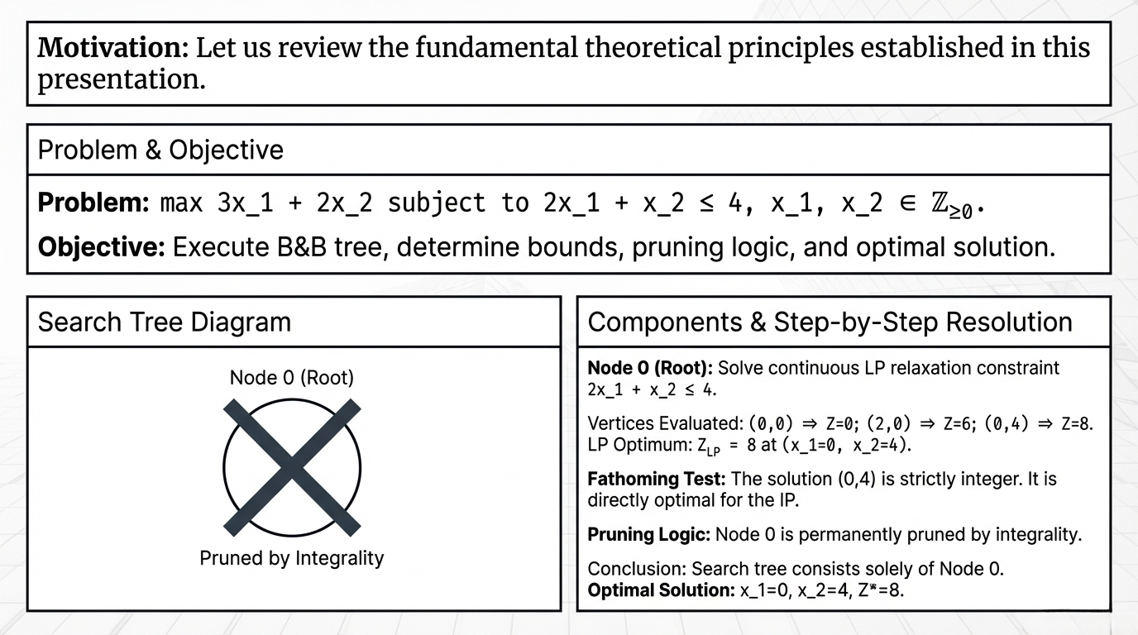
Notes:
Slide 14: B&B Example (Search Tree Execution) "In this final example, we execute the B&B tree for a simple maximization problem. At the Root Node (Node 0), we solve the continuous LP relaxation constraint and evaluate the vertices, finding the LP optimum is 8 at x_1=0 and x_2=4. Because this solution is strictly integer, it directly passes our fathoming test. Consequently, Node 0 is permanently pruned by integrality, and no further branching is needed. Our search tree consists solely of Node 0, and the optimal solution is exactly Z* = 8. Let us review the fundamental theoretical principles established in this presentation."

Slide 15
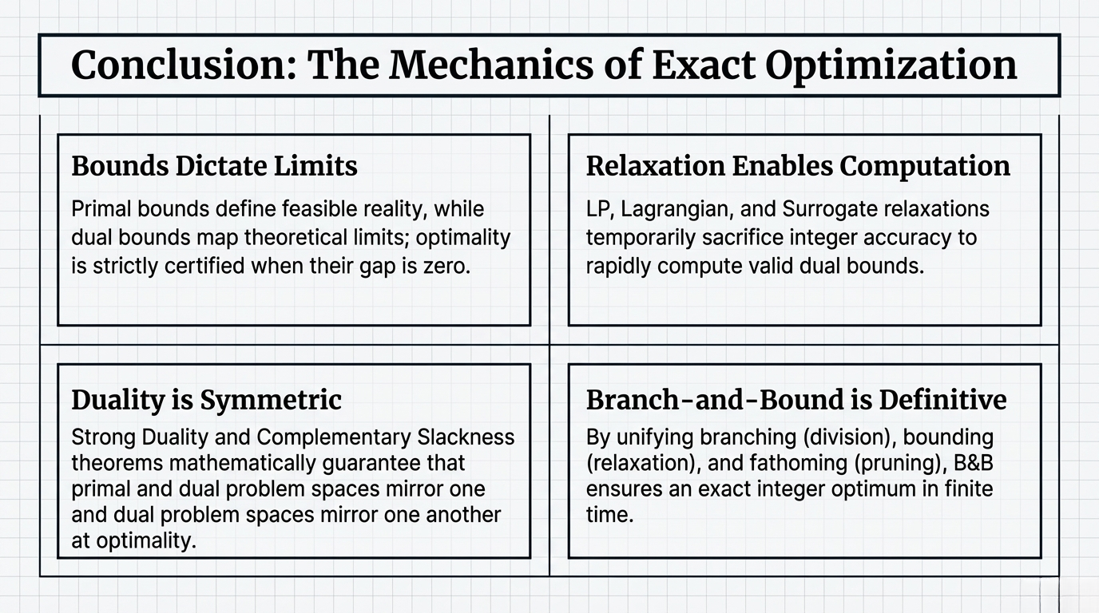
Notes:
Slide 15: Conclusion and Key Insights "To conclude, the mechanics of exact optimization rely on four core principles. First, Bounds Dictate Limits: primal bounds define feasible reality while dual bounds map theoretical limits, certifying optimality when their gap is zero. Second, Relaxation Enables Computation: LP, Lagrangian, and Surrogate relaxations temporarily sacrifice integer accuracy to rapidly compute valid dual bounds. Third, Duality is Symmetric: Strong Duality and Complementary Slackness mathematically guarantee that primal and dual problem spaces mirror one another at optimality. Finally, Branch-and-Bound is Definitive: by unifying branching, bounding, and fathoming, it ensures an exact integer optimum in finite time. Thank you."

